Slide 1

MOVING OBJECT SEGMENTATION USING GAN
MALAVIYA NATIONAL INSTITUTE OF TECHNOLOGY, JAIPUR
Under the guidance of - Presented by -
Dr. Namita Mittal Ashish Goyal (2016ucp1100)
Swaraj Thakre (2016ucp1663)

Slide 2
Contents
Moving Object Segmentation.
Applications of MOS.
Dataset Used.
Related Work .
Limitations of Previous Approaches
Motivation to use GAN.
Proposed Framework.
Experimental Setup
Quantitative and Qualitative Analysis.
Ablation Studies.
Conclusion.
References.

Slide 3
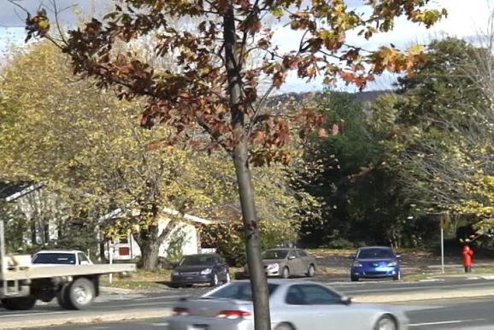

Moving Object Segmentation
The moving object segmentation (MOS) in videos with bad weather, irregular motion of objects, camera jitter, shadow and dynamic background etc scenarios is still an open challenging problem in the field of computer vision .
It is a pixel level classification task, wherein the pixels of the moving objects (foreground) in a frame are to be segmented from the pixels of background.
Fig 1. Frame from Dynamic Background category [1]
Fig 2. Segmented image of frame in Fig1.[1]

Slide 4
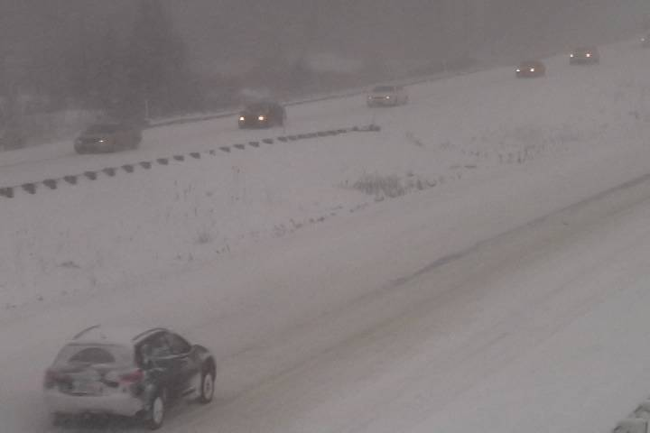
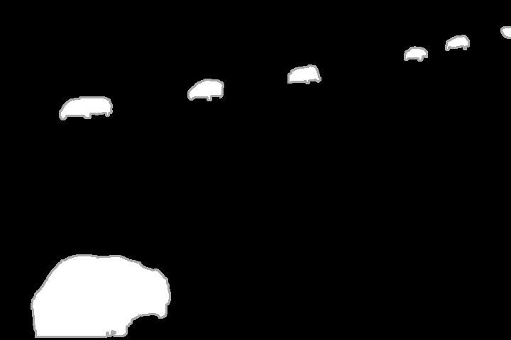
Applications of MOS.
Vehicle detection
Fig 3. Vehicle detection

Slide 5
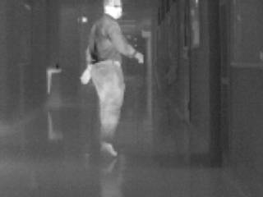

Applications of MOS (cont.)
Video surveillance
Fig 4. Video surveillance

Slide 6
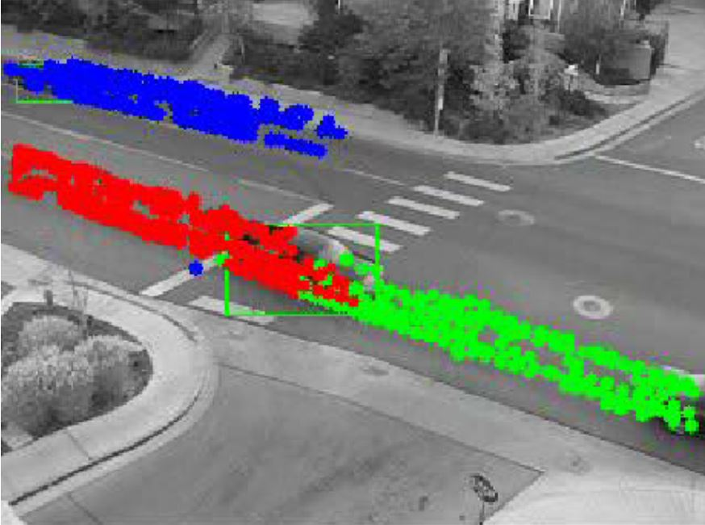
Applications of MOS (cont.)
Object tracking
Fig 5. showing 3 cars tracked simultaneously

Slide 7
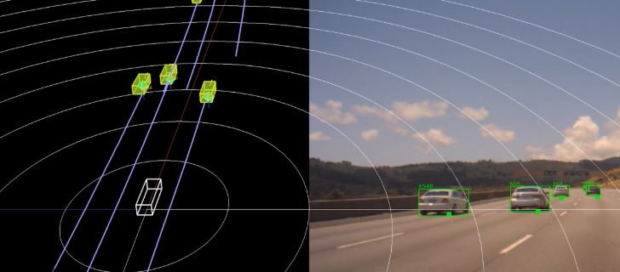
Applications of MOS (cont.)
Autonomous driving vehicles.
Fig 6. Autonomous driving vehicles.

Slide 8
Challenges in MOS and the dataset used.
We have used the CDnet 2014[1] dataset. It is the extended version of the CDnet 2012 dataset.
It consists of 11 categories wherein each category holds different challenges to be addressed. These categories include baseline, dynamic background, camera jitter, bad weather etc.
Carrying out MOS in videos of categories such as camera jitter, dynamic background etc is a difficult task as getting a background estimate in such categories is not that easy.

Slide 9
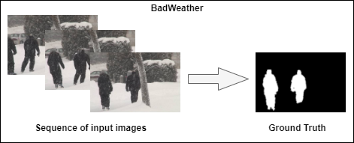
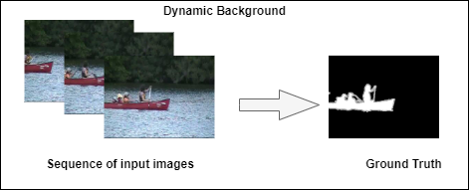
Fig 7. Example of MOS of few categories in CDnet 2014 dataset [1]

Slide 10
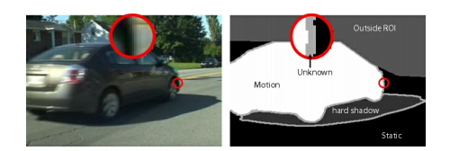
Details about ground truth in CDnet2014 dataset
Each frame has been manually annotated at pixel level
Static pixels are assigned grayscale value of 0.
Moving pixels are assigned grayscale value of 255.
Non-ROI pixels are assigned grayscale value of 85.
Shadow pixels are assigned grayscale value of 50.
Unknown grayscale value of 170 assigned to pixels that are half-occluded or corrupted by motion blur.
Fig 8. Example showing all the 5 labels [1]

Slide 11
Related Work
The notable approaches for performing the MOS task can be broadly classified into
traditional methods and deep learning based methods. Few of them are shown below:
Traditional Methods | Deep learning based methods
Yeh et al.[3] | Yang et al.[6]
Lin et al.[4] | Wenguan et al.[7]
Liao et al.[5], etc. | Chen et al.[8], etc.
Table 1. Related Work

Slide 12
Limitations of Previous Approaches.
The most widely used traditional methods for MOS is background subtraction in which the background is estimated using multiple video frames by combining the local and global information of pixel intensities.
After estimating the clean background, simple pixel-level subtraction among the calculated background frame and input video frames is performed to estimate the foreground object.
However these methods fail in performing MOS for cases wherein the background is not static e.g. dynamic background, camera jitter,etc.

Slide 13
Limitations of Previous Approaches (cont.)
As background estimation in such cases is a difficult task.
Deep learning based method have achieved significant improvement in performing MOS task as compared to the traditional approaches, but still their segmentation accuracy is not up to the mark for using these methods in real world scenarios

Slide 14
Motivation to use GAN.
Recently, adversarial training approaches are being used for semantic segmentation in medical as well as natural images.These GAN-based approaches have achieved promising result for semantic segmentation.
Inspired by them, GAN’s based approaches have been used for MOS, too. These GAN’s based approaches for MOS are broadly divided into 1) calculating a background estimate using GAN and performing background subtraction for foreground estimation 2) calculating a motion saliency estimate for each frame and enhancing it using GAN’s for foreground segmentation.

Slide 15
Motivation to use GAN (cont.)
However, instead of performing background subtraction or using motion saliency for foreground estimation we use GAN and let it implicitly learn a function for foreground estimation using the raw input image conditioned on its background.
It is inspired by the idea to learn a complex function between raw video frame and its estimated background to perform foreground segmentation rather than just subtracting the estimated background from the video frame.

Slide 16
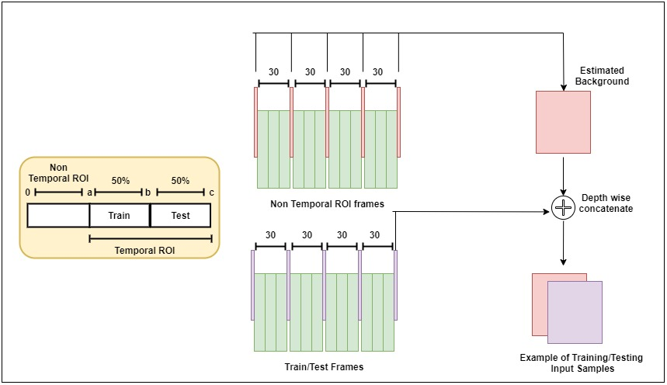
Proposed Framework
Fig 9. Data preprocessing step in our proposed framework.

Slide 17
Proposed Framework: Data Pre-Processing
This is the first step of our proposed framework. In our proposed framework result for each category of the CDnet 2014 dataset is obtained seperately.
For a given category first few frames of videos in the category are not in our temporal region of interest (ROI) [1]. We call these frames as Non temporal ROI frames as shown in Fig 9.
These first few frames from each video of a given category are thus used to calculate a background estimation for the respective videos of given category. Background is estimated by taking the depth wise median of these Non temporal ROI frames. Few examples are shown in Fig 10.
However, not all the Non temporal ROI frames are used for background estimation. We select few frames from these Non temporal ROI frames for background estimation by picking them at the gap of 30 frames as shown in Fig 9.

Slide 18
Proposed Framework: Data Pre-Processing (cont.)
The frames in the temporal region of interest are split into training and testing set.
The first 50% of the frames (in the temporal region of interest) from each video of a given category are used for training purpose, while the remaining 50% are used for the testing purpose as shown in Fig 9.
Thus now we have a train/test split for a given category, also we have estimated background for each video of a given category.

Slide 19
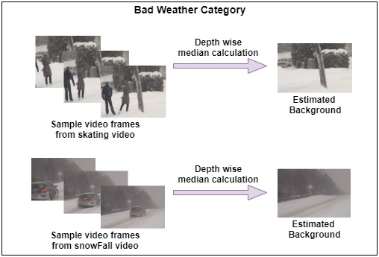
Fig 10. Above figure showes estimated background for few of the videos from Bad Weather Category.

Slide 20
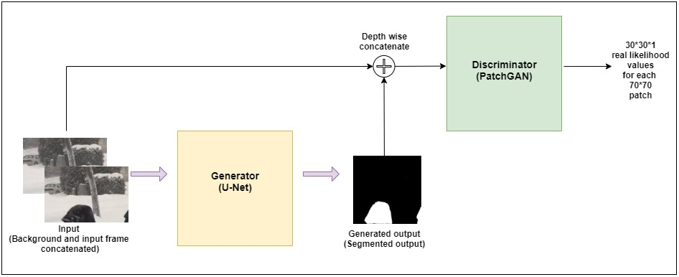
Fig 11. Training the pix2pix GAN on backgound conditioned input frames.

Slide 21
Proposed Framework
Training the GAN using background conditioned input.
After the data preprocessing step we have estimated background, training frames and testing frames for each video in all the categories of the CDnet2014 dataset.
For the training purpose we do not use all the frames in the training set of the particular video. However, we sample few frames from the training set by picking them up at a gap of 30 frames and use them for the training purpose.
These sampled frames from a particular video are than depth wise concatenated with the estimated background of that video. These depth wise concatenated frames form our input for training GAN for foreground segmentation. We use pix2pix GAN [2] for foreground segmentation purpose as shown in Fig 11.

Slide 22
Proposed Framework: Testing approach.
While testing we use the trained generator and the input to the generator are the background conditioned test frames.
As MOS is a pixel level segmentation task we calculate the F1-score for a particular category by calculating the confusion matrix at pixel level.
While calculating the values for confusion matrix thresholding is done to maximize the F1-score.
This threshold is further used to calculate PWC (percentage of wrong classification).

Slide 23
GAN's
Generative Adversarial Networks were introduced in the year 2014 by Ian Goodfellow [12].
They are extensively used in many applications because of its ability to mimic any kind of distribution of data.
It comprises of two networks, a generator and a discriminator competing against one another (that’s why it is called “adversarial” learning).
Generator generates the data from scratch, while the discriminator distinguishes the real data from the fake data.

Slide 24
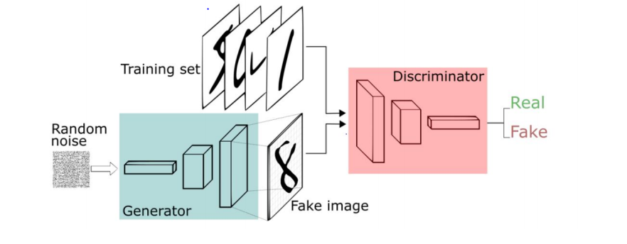
GAN's (cont.)
Fig 12. Generator and Discriminator model [13]

Slide 25
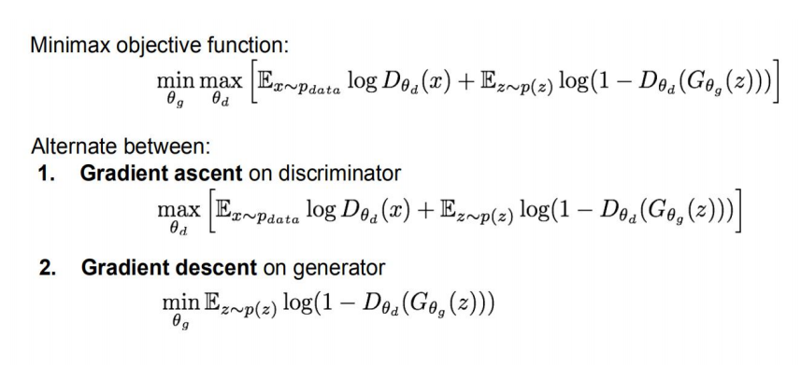
GAN's (cont.)
Objective function of GAN.
Fig 13. Objective function of GAN [12]

Slide 26
GAN's (cont.)
Discriminator outputs the likelihood in (0, 1) of real image.
P(z) is the random distribution from which our input samples z (input to the generator) are sampled.
Pdata is the probability distribution of the real samples used in the training process.
Discriminator (θd) wants to maximize objective such that D(x) is close to 1 (real) and D(G(z)) is close to 0 (fake).
Generator (θg) wants to minimize objective such that D(G(z)) is close to 1.

Slide 27
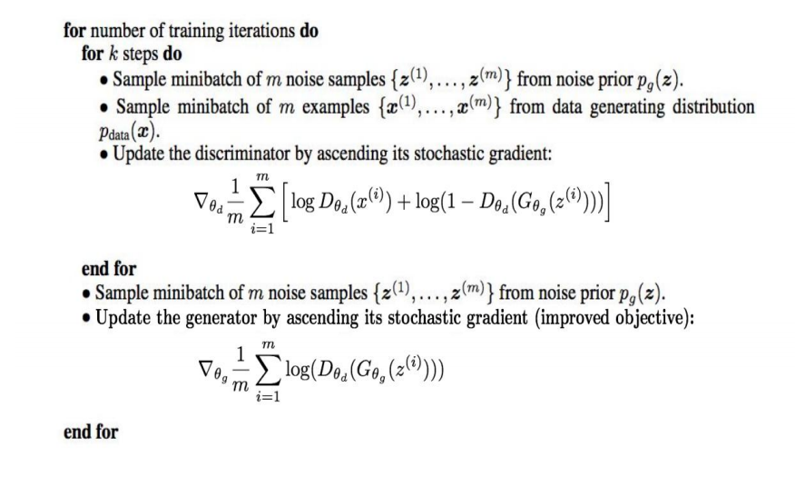
GAN's (cont.)
Fig 14. Algorithm for training the GAN's

Slide 28
pix2pix GAN
pix2pix[2] is a GAN model designed for the purpose of image to image translation.
pix2pix[2] is a Conditional GAN in which the input image is used as the label.
The generator model is provided with a given image as input and generates a translated version of the image.
The discriminator model is given an input image and a real or generated paired image and must determine whether the paired image is real or fake.
Finally, the generator model is trained to both fool the discriminator model and to minimize the loss between generated image and the expected target image.

Slide 29
pix2pix GAN (cont.)
Generator of pix2pix GAN : pix2pix[2] GAN uses U-Net architecture for its generator model, instead of a common encoder decoder model.
The encoder-decoder generator architecture involves taking an image as input and downsampling it over a few layers until a bottleneck layer, where the representation is then upsampled again over a few layers before outputting the final image with the desired size.
The U-Net model architecture is very similar in that it involves downsampling to a bottleneck and upsampling again to an output image, but links or skip-connections are made between the layers of the same size in the encoder and the decoder allowing the bottleneck to circumvent.

Slide 30
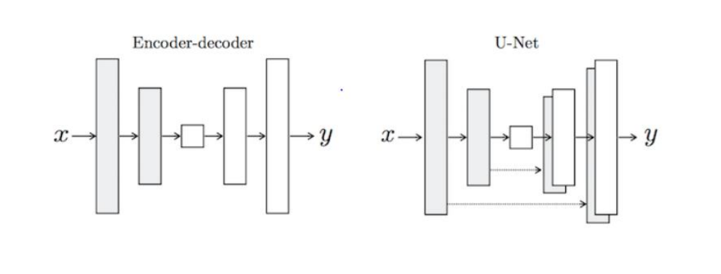
pix2pix GAN (cont.)
Fig 15. Encoder-decoder and U-Net architecture [14]

Slide 31
pix2pix GAN (cont.)
Discriminator model (PatchGAN) [2]: Unlike the traditional GAN model that uses a deep convolutional neural network to classify images, the Pix2Pix model uses a PatchGAN.
This is a deep convolutional neural network designed to classify patches of an input image as real or fake, rather than the entire image.
The PatchGAN discriminator model is implemented as a deep convolutional neural network, but the number of layers is configured such that the effective receptive field of each output of the network maps to a specific size in the input image.
The output of the network is a single feature map of real/fake predictions that can be averaged to give a single score.

Slide 32
pix2pix GAN (cont.)
Composite adversarial + L1 loss: : The generator model is trained using both the adversarial loss for the discriminator model and the L1 or mean absolute pixel difference between the generated translation of the source image and the expected target image.
The adversarial loss influences whether the generator model can output images that are plausible into the target domain, whereas the L1 loss regularizes the generator model to output images that are a plausible translation of source images.
The contribution of L1 loss to the adversarial loss is parameterized by a hyper-parameter LAMBDA.

Slide 33
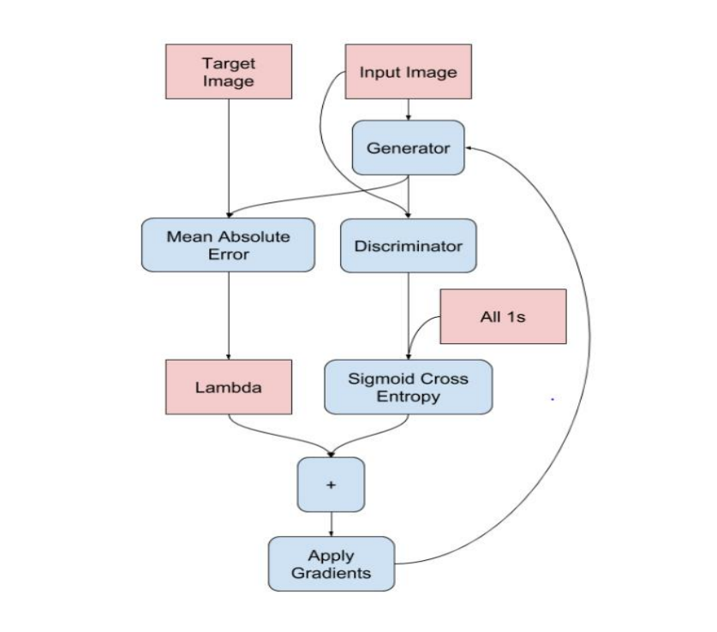
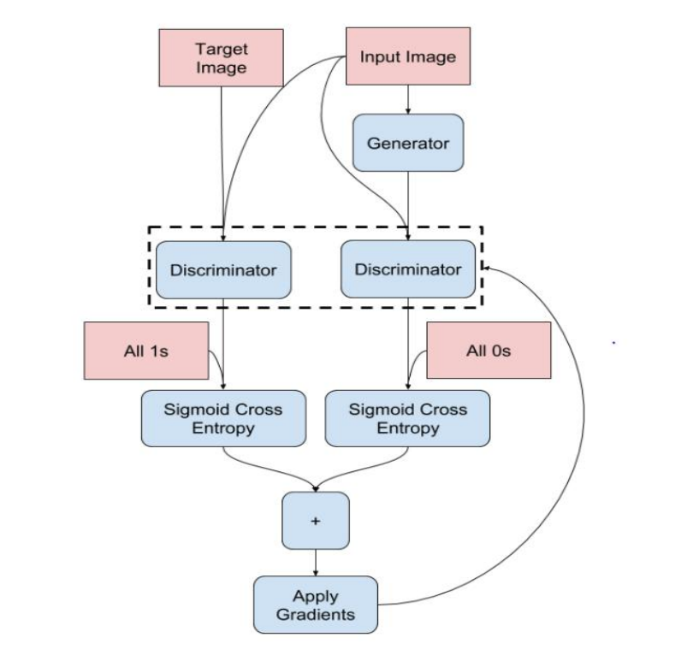
pix2pix GAN (cont.)
Fig 16. Calculation of generator loss
Fig 17. Calculation of discriminator loss

Slide 34
Experimental setup
For all our training purposes we have used Google Colab.
The input layer of the generator (U-net) of pix2pix GAN model was modified to accept input samples of size 256*256*6. The input layer of the discriminator (PatchGAN) of the pix2pix GAN model was modified to accept input samples of size 256*256*9.
Hyperparameter ‘LAMBDA’ in the generator loss of pix2pix GAN was set to 200.
Training was performed for about 200-250 epochs.

Slide 35
Quantitative and Qualitative analysis.
Category | (Chen et al.) [8] | PWS [17] | DBS [18] | FgGAN[16] | Proposed Method
Bad Weather | 0.8949 | 0.8152 | 0.8301 | 0.9734 | 0.9711
Baseline | 0.9594 | 0.9397 | 0.9530 | 0.9740 | 0.9849
Camera Jitter | 0.9422 | 0.8137 | 0.8990 | 0.9727 | 0.9173
Dynamic Background | 0.7356 | 0.9109 | 0.8906 | 0.9746 | 0.8190
Intermittent Object Motion | 0.7538 | 0.8169 | 0.6718 | 0.9658 | 0.9097
Shadow | 0.9084 | 0.8913 | 0.9304 | 0.9663 | 0.9359
Thermal | 0.8546 | 0.8324 | 0.7946 | 0.9612 | 0.9678
Average | 0.8641 | 0.8600 | 0.8528 | 0.9697 | 0.9294
Table 2. Comparison of F1-score by our proposed method on different categories of CDnet2014 dataset with other state-of-the-art methods for MOS. (Red=best, Green=second best)

Slide 36
Quantitative and Qualitative analysis.
Category | PWS [17] | DBS [18] | FgGAN [16] | Proposed Method
Bad Weather | 0.5319 | 0.3784 | 0.0619 | 0.0561
Baseline | 0.4491 | 0.2424 | 0.1807 | 0.0296
Camera Jitter | 1.4220 | 0.8994 | 0.3806 | 0.1527
Dynamic Background | 0.2723 | 0.2933 | 0.0656 | 0.3063
Intermittent Object Motion | 2.8371 | 4.4473 | 0.4250 | 0.1656
Shadow | 1.0230 | 0.7403 | 0.2476 | 0.1203
Thermal | 1.4018 | 3.5773 | 0.4956 | 0.0623
Average | 1.1339 | 1.5112 | 0.2653 | 0.1275
Table 3. Comparison of PWC(percentage of wrong classification) by our proposed method on different categories of CDnet2014 dataset with other state-of-the-art methods for MOS. (Red=best, Green=second best)

Slide 37
Quantitative and Qualitative analysis (cont.)
As seen in table 2 our proposed methods beats Chen et al. [8] by approximately 6 %, PWS [17] by approximately 7% and DBS [18] by approximately 8% in terms of F-measure.
Our trained model is light weight as compared to FgGAN still it achieves comparable result with FgGAN [16].
There is no need of post processing in our proposed method.
As seen in table 3 our proposed method has the lowest PWC of about 12.75% which is best among all.

Slide 38
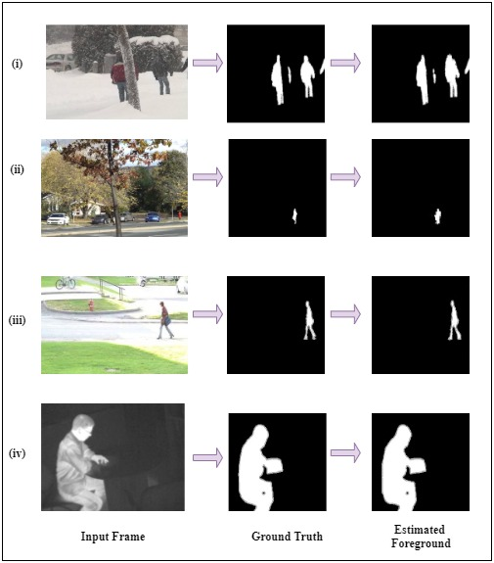
Figure 18. shows estimated foreground by our proposed method: (i) Bad weather and (ii) Dynamic Background (iii) Baseline (iv) Thermalcategory of CDnet2014 Dataset.

Slide 39
Ablation Studies (Our proposed method)
For deciding the value of hyperparameter ‘LAMBDA’ in the generator loss we varied its value from 10 to 300 at certain intervals and calculated the F1-score for dynamic background category. As you can see in table 3 the F1-score increases ‘LAMBDA’ value increases from 10 to 200 , however the F1-score decreases when ‘LAMBDA’ reaches 300. So, we fixed our hyperparameter ‘LAMBDA’ value to 200.
LAMBDA | F1-score
10 | 0.758
100 | 0.790
200 | 0.819
300 | 0.795
Table 4. Lambda value and F1-score for Dynamic background category.

Slide 40
Ablation Studies (Our proposed method)
For testing the effectiveness of background conditioned input we also performed an experiment (saliency input experiment) wherein we fed background subtracted frames to the pix2pix GAN keeping other conditions the same as our proposed methods and as seen in table 5 our method beats the saliency input experiment.
Category | Saliency input experiment | Proposed method
Dynamic background | 0.7170 | 0.8190
Table 5 . F1-Score by Saliency input experiment and Proposed method on Dynamic background category..

Slide 41
Conclusion
From the results shown, it is clear, that our proposed method shows notable improvements in terms of F-measure and PWC as compared to the various state-of-the-art methods for MOS.

Slide 42
References
[1] Y. Wang, P.-M. Jodoin, F. Porikli, J. Konrad, Y. Benezeth, and P. Ishwar. Cdnet 2014: An expanded change detection benchmark dataset. In Proceedings of the IEEE Conference on Computer Vision and Pattern Recognition Workshops, pages 387–394, 2014.
[2] isola, Phillip, et al. "Image-to-image translation with conditional adversarial networks." Proceedings of the IEEE conference on computer vision and pattern recognition. 2017.
[3]C.-H. Yeh, C.-Y. Lin, K. Muchtar, H.-E. Lai, and M.-T. Sun. Three-pronged compensation and hysteresis thresholding for moving object detection in real-time video surveillance. IEEE Transactions on Industrial Electronics, 64(6):4945– 4955, 2017.
[4]Y. Lin, Y. Tong, Y. Cao, Y. Zhou, and S. Wang. Visual_x0002_attention-based background modeling for detecting infrequently moving objects. IEEE Transactions on Circuits and Systems for Video Technology, 27(6):1208–1221, 2017.
[5]S. Liao, G. Zhao, V. Kellokumpu, M. Pietikainen, and S. Z. ¨ Li. Modeling pixel process with scale invariant local patterns for background subtraction in complex scenes. In Computer Vision and Pattern Recognition (CVPR), 2010 IEEE Conference on, pages 1301–1306. IEEE,2010.\
[6]L. Yang, J. Li, Y. Luo, Y. Zhao, H. Cheng, and J. Li. Deep background modeling using fully convolutional network. IEEE Transactions on Intelligent Transportation Systems, 19(1):254–262, 2018.

Slide 43
References
[7]W. Wang, J. Shen, and L. Shao. Video salient object detection via fully convolutional networks. IEEE Transactions on Image Processing, 27(1):38–49, 2018.
[8]Y. Chen, J. Wang, B. Zhu, M. Tang, and H. Lu. Pixel-wise deep sequence learning for moving object detection. IEEE Transactions on Circuits and Systems for Video Technology, 2017.
[9] S. Jiang and X. Lu. Wesambe: A weight-sample-based method for background subtraction. IEEE Transactions on Circuits and Systems for Video Technology, 28(9):2105–2115, 2018.
[10] Liang D, Hashimoto M, Iwata K, Zhao X, et al (2015) Co-occurrence probability-based pixel pairs background model for robust object detection in dynamic scenes. Pattern Recognition 48(4):1374-1390.
[11] Lu X (2014) A multiscale spatio-temporal background model for motion detection. In: Image Processing (ICIP), 2014 IEEE International Conference on, IEEE, pp 3268-3271.
[12]Goodfellow, I., Pouget-Abadie, J., Mirza, M., Xu, B., Warde-Farley, D., Ozair, S., Courville, A. and Bengio, Y., 2014. Generative adversarial nets. In Advances in neural information processing systems (pp.2672-2680).

Slide 44
References
[13] https://pathmind.com/wiki/generative-adversarial-network-gan.
[14]isola, Phillip, et al. "Image-to-image translation with conditional adversarial networks." Proceedings of the IEEE conference on computer vision and pattern recognition. 2017.
[15]Sultana, Maryam, et al. "Unsupervised deep context prediction for background estimation and foreground segmentation." Machine Vision and Applications 30.3 (2019): 375-395.
[16]Patil, Prashant, and Subrahmanyam Murala. "Fggan: A cascaded unpaired learning for background estimation and foreground segmentation." 2019 IEEE Winter Conference on Applications of Computer Vision (WACV). IEEE, 2019.
[17] P.-L. St-Charles, G.-A. Bilodeau, and R. Bergevin. A selfadjusting approach to change detection based on
background word consensus. In 2015 IEEE Winter Conference on Applications of Computer Vision (WACV), pages
990–997. IEEE, 2015
[18] M. Babaee, D. T. Dinh, and G. Rigoll. A deep convolutional neural network for video sequence background
subtraction.Pattern Recognition, 76:635–649, 2018.

Slide 45


